Slide 1
Object Oriented Programming
Access Specifiers

Slide 2
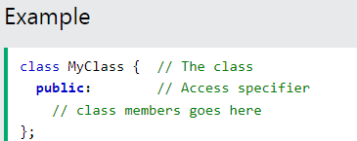
Access Specifiers
you are quite familiar with the public keyword that appears in all of our class examples:
The public keyword is an access specifier.
Access specifiers define how the members (attributes and methods) of a class can be accessed.
In the example above, the members are public - which means that they can be accessed and modified from outside the

Slide 3
Access Specifiers
However, what if we want members to be private and hidden from the outside world?

Slide 4
Access Specifiers
In C++, there are three access specifiers:
public : members are accessible from outside the class
private : members cannot be accessed (or viewed) from outside the class
Protected: members cannot be accessed from outside the class, however, they can be accessed in inherited classes. You will learn more about Inheritance later.

Slide 5
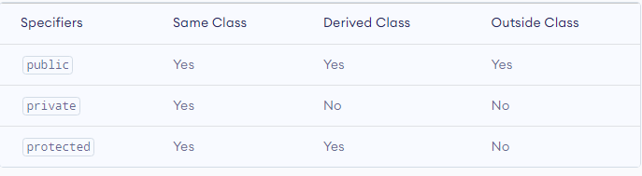
Access Specifiers

Slide 6
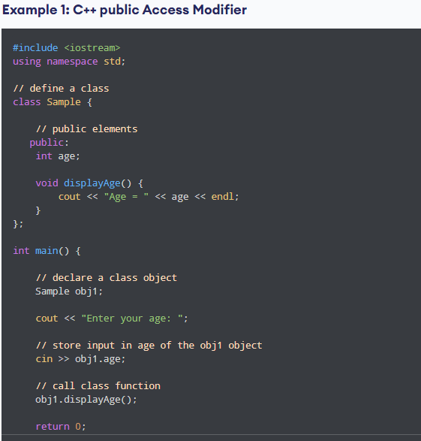
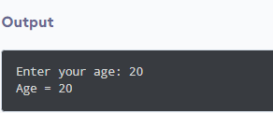

Slide 7
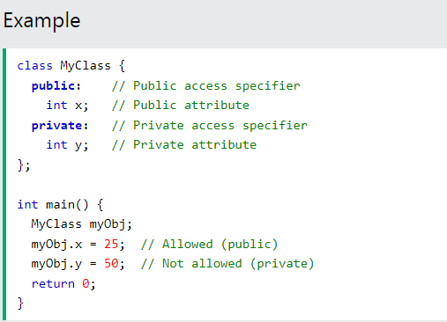
Example: Private Access Specifiers
Error:
If you try to access a private member, an error occurs:
error: y is private

Slide 8
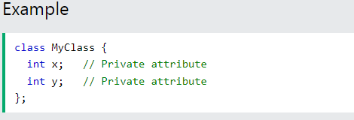
How to access private members?
It is possible to access private members of a class using a public method inside the same class (Encapsulation).
It is considered good practice to declare your class attributes as private and methods public.
By default, all members of a class are private if you don't specify an access specifier.

Slide 9
Encapsulation
The meaning of Encapsulation, is to make sure that "sensitive" data is hidden from users OR to make sure that "sensitive" data is hidden from users.
Data and Behavior are tightly coupled inside an object and both the information structure and implementation details of its operations are hidden from the outer world.

Slide 10
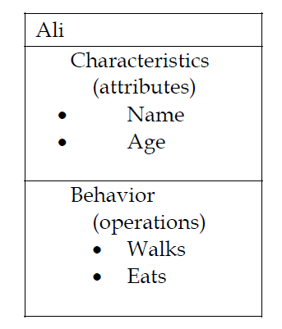
Example of Encapsulation

Slide 11
Encapsulation
Implementation of Encapsulation:
To achieve this, you must declare class variables /attributes as private (cannot be accessed from outside the class).
If you want others to read or modify the value of a private member, you can provide public methods.

Slide 12
